Slide 1


Cart Abandonment & Dark-Store Replenishment Triggers
Using AI to predict abandoned carts and restock dark stores before they run out · Blinkit / Zepto context
AI Foundations for Managers · Semester 1, 2026 · [Section] – [Group number]
All data is synthetic (dummy) and generated in Python
Notes:
Introduce the team and the topic. One-line pitch: quick-commerce apps lose money when carts are abandoned and when dark stores run out of stock, and the two are linked. We built two AI models on synthetic data to fix both.

Slide 2
Two linked leaks in quick commerce
Dark stores promise ~10-minute delivery from a small stock. When an item runs out, carts lose items – and customers leave.
33.4%
30% → 51%
₹1.6 lakh
of carts are abandoned
abandonment without vs with an unavailable item
revenue lost to stock-out abandonment
1,661 of 4,975 sessions
stock-outs drive abandonment
in our dataset
Problem statement: How can AI identify carts likely to be abandoned and trigger dark-store restocking before products run out?
Notes:
Two problems: one in three carts abandoned; stock-outs. The link is the key insight: carts with an unavailable item are abandoned 51% of the time vs 30%. That cost about Rs 1.6 lakh in our data.

Slide 3




Project objectives
Predict abandonment
Make nudges profitable
Score every cart's risk of being abandoned at checkout
Act only on high-risk carts, with an action matched to the reason
Forecast demand
Trigger replenishment
Predict next-day units for each product in the dark store
Raise a reorder alert with a suggested quantity before stock runs out
Notes:
Four objectives that map to the brief: two prediction tasks and two business actions. Tools: Python in Jupyter, scikit-learn, Streamlit for the demo.

Slide 4



Stakeholders and the decisions we improve
Dark-store manager
Decision | Current process | With AI
Which carts get a recovery action? | Same coupon or reminder for everyone | Risk score per cart; act only when risk ≥ 0.6, with a matched action
When and how much to restock? | Fixed weekly order from last week's sales | Daily forecast + reorder-point trigger + suggested quantity
approves reorders
Supply-chain planner
plans deliveries
Growth & marketing
runs cart nudges
Customers benefit too: items in stock, fair fees, honest delivery times.
Finance
tracks spend & stock
Notes:
Name each stakeholder and what they get. Then the two decisions: before, the same treatment for everyone and a calendar-based order; after, a targeted action and a demand-based trigger.

Slide 5
Why AI – and which AI
Need | AI type | Technique
Will this cart be abandoned? | Classification | Logistic Regression (plain, balanced), Random Forest
How many units tomorrow? | Regression (time series) | Random Forest with lag features
When to reorder? | Decision rule on forecast | Reorder point + safety stock
Baselines compared | Non-AI | Nudge everyone; weekly order; 7-day moving average
Why AI fits
Abandonment depends on many factors at once
Thousands of carts and products every day
Demand has weekly patterns to learn
Each prediction maps to a costed decision
Notes:
Why AI rather than rules: many interacting factors, scale, learnable patterns. Two supervised learning tasks plus a decision rule. Always compared against a non-AI baseline.

Slide 6

Synthetic data and how we cleaned it
Data-quality issues added on purpose, then fixed
Cart sessions
Issue | Rows | Fix
Duplicate events | 50 | Keep first record
Missing ETA | 100 | Fill with median (25 min)
Cart value ≤ 0 | 25 | Remove
Result | 5,050 → 4,975 | 0 missing values
4,975 carts · cart value, delivery fee, items, unavailable items, ETA, previous orders, discount → abandoned (0/1)
Dark-store inventory
Privacy: DPDP Act 2023 – consent, purpose limitation, pseudonymised IDs, no protected attributes
30 products × 90 days · daily sales, lead time (1–3 days), price, safety stock, current stock
Notes:
Brief allows dummy data. Seed 42 so results repeat. We deliberately added three real-world data problems and cleaned them. In real life: app clickstream, order database, warehouse system.

Slide 7




Solution design: one pipeline, two models
Model 1 – carts
Nudge rule
Balanced Logistic Regression
Risk ≥ 0.6 → matched action
fewer stock-outs →
fewer abandoned carts
Data
Preparation
Dashboard
Cart events · stock & sales
Clean · lag features
Manager approves
Model 2 – demand
Trigger rule
Random Forest forecast
Stock ≤ reorder point → order
Built in Python (pandas, scikit-learn) in Jupyter; demo in Streamlit
Notes:
Walk left to right. One data pipeline feeds two models; each model drives a business rule; both land in the manager's dashboard. The dashed arrow is the project's core idea: better restocking also reduces abandonment.

Slide 8
What drives cart abandonment
Insight: two unavailable items more than double abandonment (30% → 70%). Fees and longer ETAs (21% at ≤10 min vs 44% at 31–45 min) also push customers away.
Notes:
Exploratory analysis. Left: stock-outs. Right: fees. Delivery time shows the same pattern. These drivers become the model's features.

Slide 9
Model 1: choosing the cart-abandonment model
Selection rule
Keep models within 0.01 ROC-AUC of the best (all three: 0.73–0.74)
Pick the highest recall – a missed abandoner costs a whole cart
On a tie, prefer the explainable model
Winner: Balanced Logistic Regression – recall 66% vs 39% for the plain model
Notes:
Three models, same 995 test carts. Accuracy alone misleads: the plain model looks best on accuracy because it predicts 'completed' most of the time and misses 61% of abandoners. Class balancing fixed that. Confusion matrix: 220 caught, 112 missed, 215 wrong alarms.

Slide 10
Why carts are flagged – and when to act
Act only when risk ≥ 0.6: +₹3,121 vs −₹2,201 for nudging everyone. Action matches the reason – substitute, fee waiver or clearer ETA.
Notes:
Left: fee, delivery time and unavailable items raise risk; loyalty and discounts lower it. Unavailable items look weak in Random Forest importance only because they are rare (15% of carts). Right: assumptions Rs 20 per nudge, 25% saved, 20% margin. Nudging everyone loses money.

Slide 11
Model 2: forecasting demand, firing triggers
Trigger rule (daily, per product)
Reorder point
= forecast × lead time + safety stock
Safety stock
= 1.65 × σ(daily sales) × √lead time
Example – Milk: stock 77, reorder point 132 → REORDER NOW, order 264 units. 15 of 30 products trigger today.
MAE 8.55 vs 8.90 units/day – Random Forest is 4% better than the moving average; trained on days 8–70, tested on 71–90.
Notes:
Forecast features: sales 1, 2 and 3 days ago, 7-day average, weekday. Chronological split so no future data leaks in. Then explain the reorder-point formula with the milk example.

Slide 12
Back-test: AI triggers vs weekly ordering
93.7% → 99.95%
Fill rate
67 → 2
Stock-out product-days
₹3.23 lakh → ₹1,101
Revenue lost in 20 days
180 → 110
Most of the gain comes from daily trigger logic; the AI forecast loses slightly less revenue than the moving average (₹1,101 vs ₹1,563).
Avg units held per product
Notes:
We replayed the real demand of the last 20 days under three policies. Daily triggers nearly eliminate stock-outs and hold about 40% less stock. Be honest: the moving-average trigger is almost as good; the trigger logic does most of the work.

Slide 13
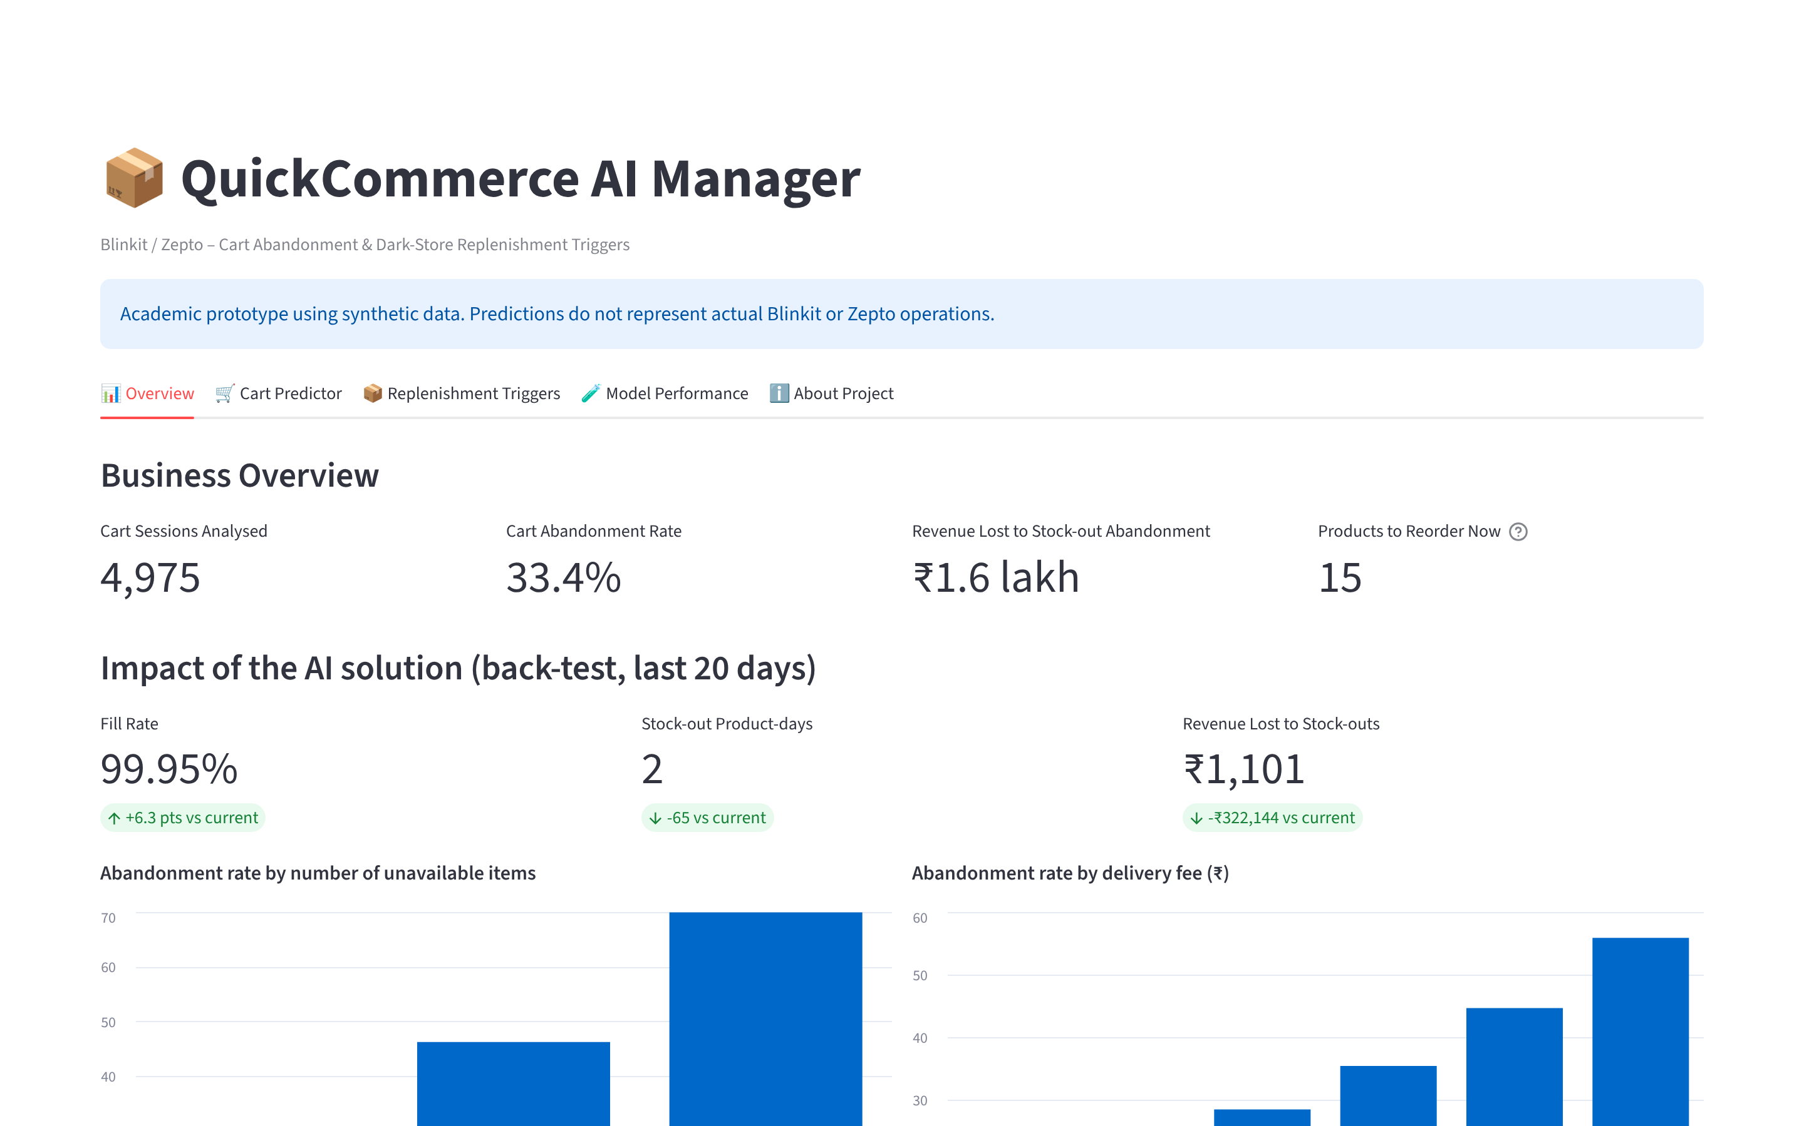
Live demo: QuickCommerce AI Manager
Demo flow
Overview: KPIs and AI impact
Cart Predictor: a risky cart, then a safe one
Triggers: explain one REORDER NOW row
Change incoming stock: manager override
Model Performance: comparison tables
Run: streamlit run app.py
Notes:
Switch to the browser (streamlit run app.py). Follow the demo script in the prep doc: overview, risky cart with defaults, safe cart (fee 0, no unavailable items, ETA 10, 20 previous orders), trigger board, model tables. If the laptop fails, use these screenshots.

Slide 14

Business value and KPIs
KPI | Baseline | With AI (prototype)
Model recall (abandoners caught) | 39% (plain LR) | 66%
Net profit of nudges, 995 carts | −₹2,201 (nudge all) | +₹3,121 (risk ≥ 0.6)
Fill rate | 93.7% | 99.95%
Stock-out product-days (20 days) | 67 | 2
Revenue lost to stock-outs (20 days) | ₹3.23 lakh | ₹1,101
Average stock held per product | 180 units | 110 units
Cart abandonment rate | 33.4% | Measure in pilot (A/B test)
More completed orders
Lower discount spend
~40% less stock, less wastage
Faster, consistent decisions
Assumptions: ₹20 per nudge, 25% saved, 20% margin; synthetic data.
Notes:
Summarise the measurable value. State the assumptions openly. Abandonment rate itself must be measured in a real A/B test.

Slide 15




Risks and responsible AI
Synthetic data
Responsible AI
Retrain on real data; pilot with A/B test
Human in the loop: manager approves every order
Customers game nudges
Cap nudges per customer; prefer substitutes
Privacy: DPDP Act 2023, pseudonymised IDs
Over-ordering perishables
Shelf-life limits; manager approval
Fairness: no protected attributes
Demand shifts (festivals, rain)
Transparency: explainable model, reason on every trigger
Weekly monitoring; regular retraining
Notes:
Admit the limitations before being asked. No fake urgency in nudges. The AI recommends; people decide.

Slide 16
Implementation roadmap
Weeks 1–4
Weeks 5–8
Weeks 9–16
Months 5–8
Ongoing
Data foundation
Model build
Pilot
Scale-up
Monitor
Connect cart, order and stock data; privacy review
Retrain on real data; validate on recent weeks
A/B test in 3 dark stores; train managers
More stores; hourly forecasts; ordering integration
Weekly KPI reviews; monthly retraining
Pilot success = lower abandonment and fewer stock-outs than control stores
Notes:
The pilot in phase 3 is the key gate: A/B test against control stores before scaling.

Slide 17
Fix availability, and carts follow
Unavailable items push abandonment from 30% to 51% – the two problems are one
Balanced Logistic Regression catches 66% of abandoners; targeted nudges turn a loss into a profit
Daily AI triggers: fill rate 99.95% with ~40% less stock in the back-test
Next step: pilot on real data in 3 dark stores with an A/B test
Notes:
Close with the four takeaways, then invite questions.

Slide 18
Thank you
Questions welcome
[Section] – [Group number]: [Member 1] | [Member 2] | [Member 3] | [Member 4] | [Member 5] | [Member 6]
Notes:
Fill in the team names before presenting.

